Slide 1






Navigating SharePoint for RIM in the Microsoft Cloud
San Diego, CA
June 22nd, 2017
Unify
Your Infrastructure
Manage
People and Teams
Modernize
Business Solutions

Slide 2


We provide solutions to unify, manage, modernize, and bring intelligence and automation to enterprise content systems.
All of your content is critical; leverage our decades of experience and technology to unite your content, processes and users on a single, modern, enterprise content and records management platform.

Slide 3
Overview: Our Plan for Today
High-Level Agenda
12:00 | Welcome, Agenda Review, Opening Notes
12:10 | RIMtech EDRMS Market Overview, SharePoint POV for RIM, and RBR
12:30 | ShareSquared Presentation: RBR Content Types and Migration
12:50 | Questions, closing comments

Slide 4

ShareSquared: Our Commitment
What you can count on from us today:
No selling, convincing, or defending
No attachment to outcome
No expectation
We’re investing in ARMA to:
Openly and freely share from our experience
Educate and empower the ARMA SD team
Provide insight and connection
You can depend on us to:
Stay tightly coupled with Microsoft
Rigorously pursue the cloud
Objectively vet all our technology partners

Slide 5

Team: Chris Givens, CTO
MCSE, MCAD, MCDBA, MCT, CTT+, CISSP, CCNP, OCA MCTS – SharePoint, BizTalk & SQL
Chris Givens, ShareSquared’s Chief Technology Officer, is a world-renowned Microsoft SharePoint MVP and Principal SharePoint Consultant/Architect, and developer. He is the Co-founder and President of the San Diego SharePoint User Group (SanSpug.org).
Chris has worked with SharePoint for over a decade and recently consulted on many high-profile projects with organizations such as the County of Los Angeles, County of San Diego, eBay, PayPal, the Bill and Melinda Gates Foundation and General Atomics. As a direct assistant to the Executive Team at IBM, Chris participated in immersive trainings honing his deep technical and business skills.
Chris has a passion for teaching, is a Microsoft Certified Trainer and has developed Microsoft Official Curriculum courseware for all versions of SharePoint with topics ranging from Development and Business Intelligence.

Slide 6
ShareSquared: Our Presenters
David Kruglov
Managing Director
John Honeycutt
Chief Strategist
Executive Sponsor
ECM Specialist
Los Angeles, CA
Portland, OR
We’re here to be in service…
Committed to the Digital Transformation of State and Local Government

Slide 7











RIMtech: Bruce Miller
Vendor-Neutral SME
Records Software Developer
  Documentum, IBM
Independent consulting
Industry thought leader
Author
  Managing Records in Microsoft SharePoint
  TCA for Recordkeeping
Educator
  Seminars, conferences

Slide 8









ShareSquared: Solution Focus
Public Sector Solutions:
SharePoint and Office365
GO2 for Rapid Deployment
Intranets and Extranets
Content Migrations
Document Management
Certified Records Management
Local Government Solutions
Public Sector Verticals:
City and County Government
Health and Human Services
Public Safety
Transportation
Water and Power Utilities
Housing Authorities
Representative Public Sector Customers:

Slide 9




ShareSquared: EDRMS Experience
Existing EDRMS/SP Projects:
City of Richland, WA - Collabware
County of San Mateo – SP + Custom Solution
City of Bellevue, WA – Stellant Migration to SP/Gimmal
Sacramento Sewer District – OOTB/Gimmal
North Los Angeles Community Resource Center – OOTB
Altera Corporation – SP + Custom Solution
Imperial Irrigation District – SP OOTB
First 5 Los Angeles (County of LA) – Gimmal
City of Pasadena, CA – Gimmal
County of San Diego - RecordLion

Slide 10
Approach: Legacy Content Migration
Legacy ECM Migration Clients/Systems:
Customer | Repository Migrated From
City of Bellevue, WA | Oracle Stellant
County of Los Angeles – Public Works | IBM FileNet
Imperial Irrigation District | IBM FileNet
County of San Mateo, CA | Oracle Stellant
City of Salt Lake Public Utility | OpenText Hummingbird
City of Richland, WA | Oracle Stellant
Sacramento Sewer District | IBM FileNet
Port of San Diego | Documentum
City of Pasadena | Questsys
First 5 Los Angeles | ApplicationXtender

Slide 11
















ShareSquared: Partner Network
Carefully vetting the best industry solutions for you

Slide 12
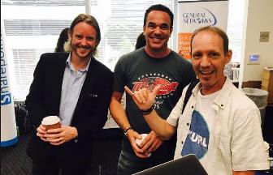
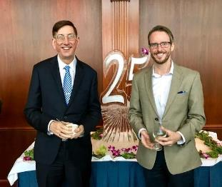
ShareSquared: Ecosystem Connections
Executive 1:1s
Michael Donlan – US SVP SLG
Bill Baer – Sr. Product Manager SharePoint
Chris Caplinger – CEO RecordLion
Mike Alsup – Founder Gimmal
Elon Aizenstros – CEO RecordPoint
Peter Loo – CIO LA County (110k users)
Boards and Associations
SharePoint Partner Advisory Council
Microsoft ISU for US SLG
Microsoft CityNext and BCSP
Member/Supporter/Exhibitor:
  ARMA International
  MER
  AIIM International
  SharePoint Saturday

Slide 13
RIMtech: Bruce Miller
Vendor-Neutral SME
Records Software Developer
  Documentum, IBM
Independent consulting
Industry thought leader
Author
  Managing Records in Microsoft SharePoint
  TCA for Recordkeeping
Educator
  Seminars, conferences

Slide 14

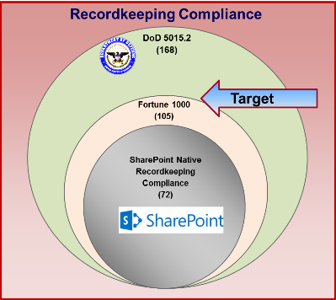
SharePoint Does Not Deliver RIM Compliance
Requirements
Retention Schedule
Proven classification accuracy
  Minimum 85% across millions of records!
Deletion Oversight
  Disposition certificates
  Business approvals
Case Record handling
  Groupings of related records
Legal Hold
e-Discovery
All record forms
  Email, documents, images, paper, artifacts

Slide 15
(3) Foundational RIM Deficiencies

Slide 16

ADG Does not Deliver RIM Compliance
O365 E5 Release
ADG
Records Management
Data Loss Prevention
Identify Sensitive Information
Threat Protection
Policies (of all types)
e-Discovery
Non-Records Cleanup
Unmanaged Duplicates
Retention Schedule
Legal Holds
Records Classification
  To 85% accuracy
Physical Records
Human Oversight

Slide 17
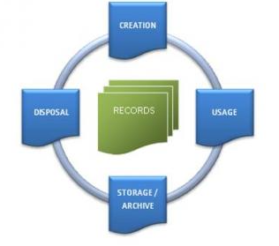
Needed To Achieve Compliance?
Retention Schedule
Disposition
  3-Stage legally defensible deletion of records
  In accordance with retention schedule
  Human Oversight (not automatic)
RBR
  Rules-Based Recordkeeping
  Manage records without user participation
Case Handling (event-based records)
  Leveraging Metadata
  Allow External event dates in retention policies
Game-Changer

Slide 18
What does EDRMS Look Like?
Documents get locked down automatically
Documents go away
Cleanup happens via ADG
Daily measurement of classification accuracy
Periodic massive deletion (Disposition)
Periodic Holds, FOI Access
Records Software = invisible to users
Users do not learn, understand, or use recordkeeping features
EDRMS = Electronic Document & Records Management System

Slide 19
How to achieve Compliance in SharePoint/O365?
Third-Party Add-in Software
Four products, three vendors
All deliver F1000 recordkeeping compliance
  Retention schedule
  Disposition
  RBR
  Case Handling
  Physical Records
  Legal Holds

Slide 20


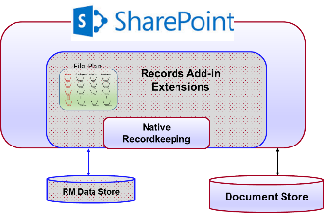

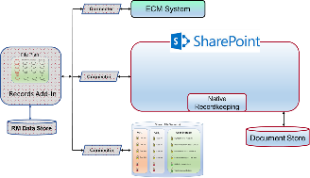


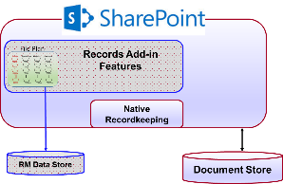

(3) RM Add-In Designs, (4) Products

Slide 21



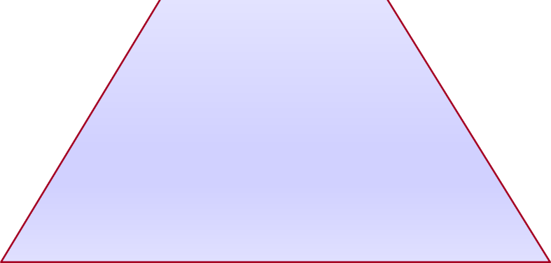


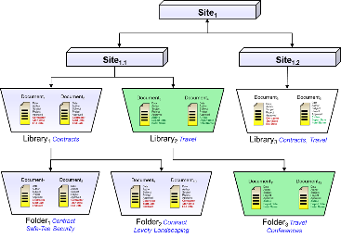
SharePoint Structure
Aligned
With Records
Step 3 Compliance
Compliance
End User Experience
Step 2 Records Management
RBR
Rules
Retention
Schedule
Metadata
Step 1 SharePoint

Slide 22
SharePoint Structure
Not Aligned
With Records
Step 3 Compliance
Step 2 Records Management
RBR
Rules
Retention
Schedule
Metadata
Step 1 SharePoint

Slide 23
(5) Steps of an EDRMS Implementation
Build/Fix Retention Schedule
  Make it Software-Ready
Metadata Mapping
  Define Business Metadata
RM Add-In Software
  Select/Install/Configure
Configure SharePoint + RM Software
  Content Types/Libraries/etc.
Define RBR Rules
  Automate declaration, classification

Slide 24
EDRMS Ready Retention Schedule
Spreadsheet Format
  One tab for each Primary (Business Function)
  One row for each category (Business activity)
Ignores organizational Structure
Companion document
  Data Nomenclature Standardization
Explicit Case Designations
Specifies (4) Types of Retention
  Event
  Time
  Relationship
  Document Field Property
Two separated retention Periods
  Business retention period
  Official (Legal) retention period

Slide 25
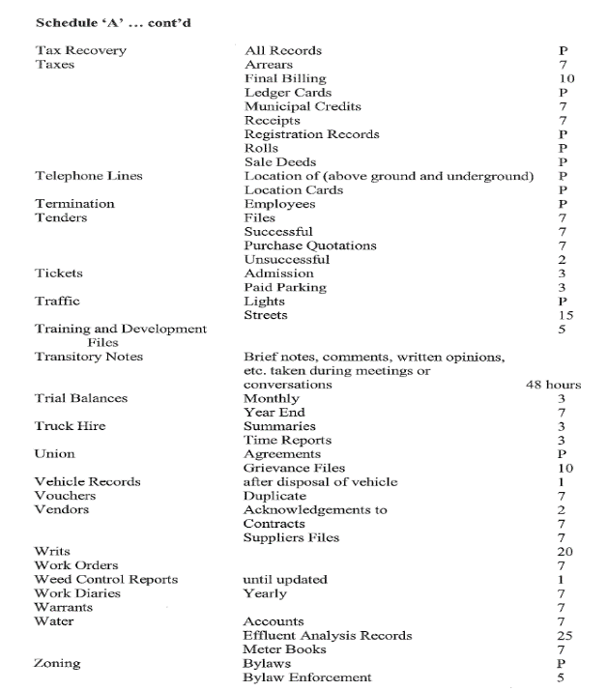
We Need to Move From This…

Slide 26
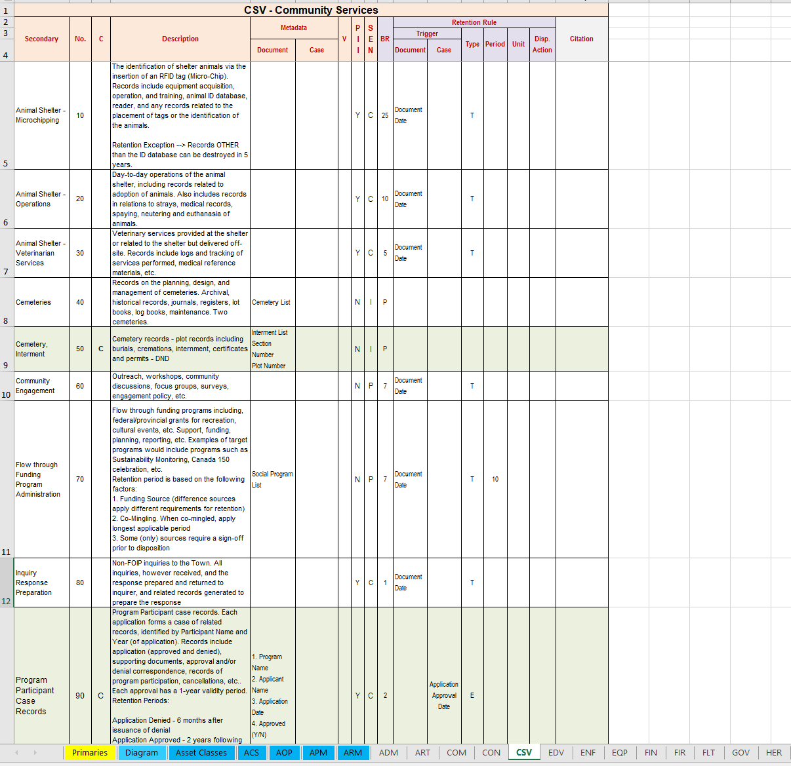
To This..

Slide 27
The Big 4 EDRMS Mistakes
Expectations Doomed to Failure
Expect End Users to
1. Identify Records of Business Value
2. Classify Records Against Retention Schedule
3. Declare Documents as Records
4. Store Documents Where we Want

Slide 29
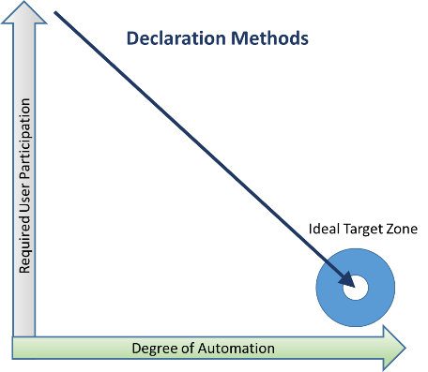
Rules-Based Recordkeeping (RBR)
Automate the Recordkeeping
  No User Declare
  No User Classify
Create Document Handling Rules (DHRs) to Specify:
  Which Documents to Declare
  When to Declare
  How to Classify Against File Plan
  Move to Another Location (optional)
RBR = Technology + Technique

Slide 30
Using Content Rules to Classify
Content Type
Fields (Columns)
Field Values
Contracting
Date
Subject
Safe-tee Security
Contractor
Lovely Landscaping
Status
Tasty Catering
Category
04-50-1
Content Type
Fields (Columns)
Field Values
Employment
Date
Subject
707 Smith, J
Employee #
808 Rubble, B
Status
909 Jones, L
Category
03-10-808

Slide 31
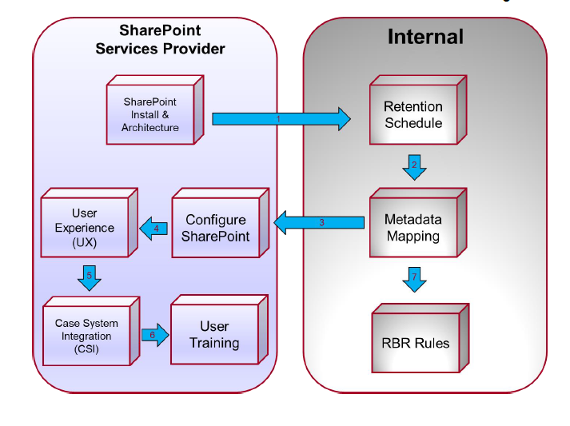
Who Does What?

Slide 32
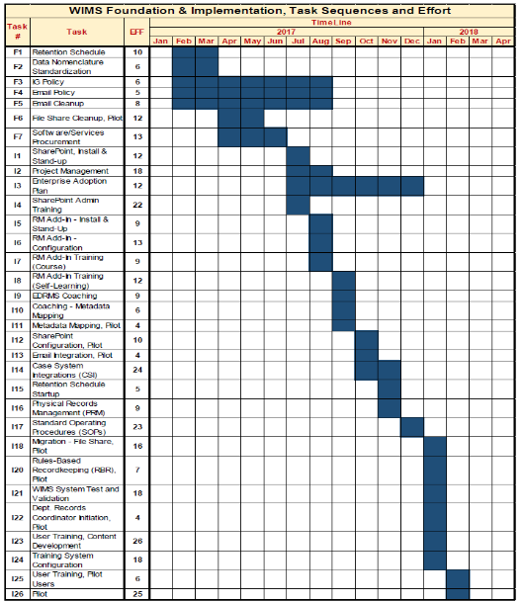
Phase 1 – Foundation & Implementation
Foundation & Implementation Stage

Slide 33
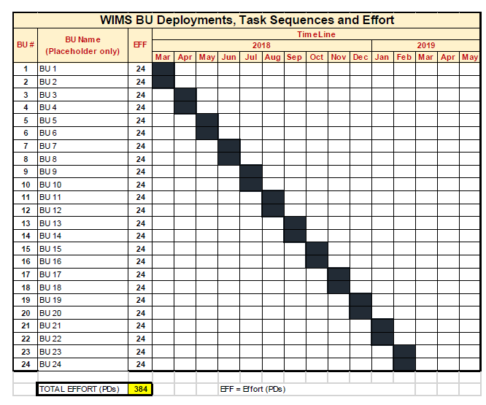
Phase 2 - Deployment
Deployment Stage

Slide 34
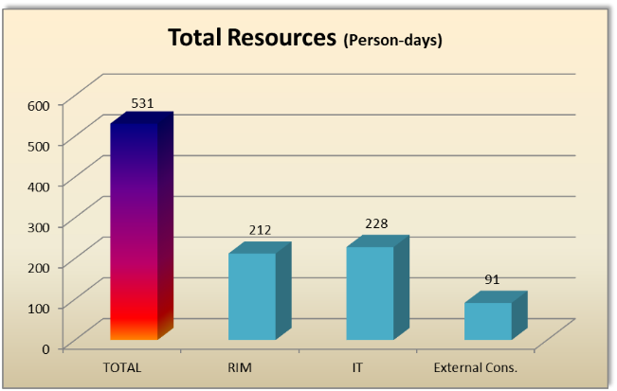
Typical Required Resources (1,000 users)
Over 500 PDs needed
Need 1 new FTE in RIM
Need 1 FTE Consulting/Vendor in Year 1 (only)
Need 1 RIM FTE dedicated in Year 1
Need 1 FTE IT Added in Year 1 for Build

Slide 35



Education is the Key
Develops the Confidence to Deploy
IT needs to learn RIM Compliance
RIM Needs to learn SharePoint
RBR is not well known
SharePoint Services Providers must be strong on RIM
RIMtech has a Proven EDRMS Deployment Methodology
Education is the key to EDRMS Success
Bruce Miller, RIMtech

Slide 36
Team: Chris Givens, CTO
MCSE, MCAD, MCDBA, MCT, CTT+, CISSP, CCNP, OCA MCTS – SharePoint, BizTalk & SQL
Chris Givens, ShareSquared’s Chief Technology Officer, is a world-renowned Microsoft SharePoint MVP and Principal SharePoint Consultant/Architect, and developer. He is the Co-founder and President of the San Diego SharePoint User Group (SanSpug.org).
Chris has worked with SharePoint for over a decade and recently consulted on many high-profile projects with organizations such as the County of Los Angeles, County of San Diego, eBay, PayPal, the Bill and Melinda Gates Foundation and General Atomics. As a direct assistant to the Executive Team at IBM, Chris participated in immersive trainings honing his deep technical and business skills.
Chris has a passion for teaching, is a Microsoft Certified Trainer and has developed Microsoft Official Curriculum courseware for all versions of SharePoint with topics ranging from Development and Business Intelligence.

Slide 37
ShareSquared: Records Management
ShareSquared has experience with all major RM systems for SharePoint
  Collabware
  Gimmal
  RecordLion
  RecordPoint
Deep knowledge of advantages and disadvantages of each platform
  Ask us where things are going and what really works!

Slide 38
RBR Implementation in RM Systems
Mileage will vary
Not all systems were coded the same
  This is good and bad…
Not all systems run inside SharePoint
  This is good and bad…
Not all systems can handle 400+ content types and the file plan rules to support it
  We have tricks to implement RBR

Slide 39
How do you get to RBR utopia?
Migrate!
RBR is an advanced RM methodology that makes sense in today’s massive data generation world
  If you can’t find it today, how are you going to find all the new content tomorrow?
  Are you disposing of the right items? Are you even dispositioning it at all?
Old systems are quickly becoming out of date and unsupported
  Many lack basic features (aka search – 500 records max)
  Systems like O365, SharePoint and 3rd party RM software vendors make implementing RBR and RM easy

Slide 40
But migration is hard and expensive!
Not if you know what you are doing…
You CAN move from your old systems to the new shiny updated systems of today
Doing it yourself will be very hard and probably manual, look for outside help
PowerStreamECM supports the migration of many legacy systems to SharePoint and O365 to support the RBR methodology

Slide 41
PowerStreamECM: Features
ECM systems
  FileNet, OpenText, Documentum, iManage, Hummingbird, Questys, Exchange, Fileshares
Old file format conversions (TIFF to PDF to PDF/A)
  Binary file verification (is it really a TIFF?)
OCR support
  Turn TIFFs into indexable archivable PDFs
  Populate missing metadata from source documents (CustomerID, etc)
Multi-threaded, multi-server architecture
  Move 100K of records in hours, not weeks
Advanced rules and metadata engine
  Customer facing workbook for rules and metadata mappings

Slide 42
Next Steps: How to Engage
Discussion/Envisioning: engage us for a more detailed presentation to your team, executives and other stakeholders
GamePLAN: for strategic road-mapping
ROM: support budget with rough order of magnitude estimates
RFPs: share past procurements to help develop scope; working with master contracts, inter-locals, etc.
Pilots: limited scope pilots or proofs of concept
Partner: solution development (agenda management, et al)

