Slide 1
Cybersecurity: Practical Applications
By:
John Feist - Applied Cyber Technologies
CISSP, CISA,C|CISO, CRISC, CEH, CPT
&
Matt Stamper - Board of Advisors & CISO In Residence
(MPIA, MS, CISA, ITIL, CIPP-US)
Notes:
Quick Intro. We have lots of data to present
Bios in Backup slides

Slide 2
We are under attack!
10 New strains of malware/second – Symantec 2015
81% delivered through browsers – Ponemon Institute 2015
$105B Cyber Attack prevention – Markets and Markets 2015
$491B Cyber Attack Recovery – IDC 2014
231 Vulnerabilities in Internet Explorer 2015 (MS is not alone: Chrome, Firefox…)
Adversaries are distributing really good fake threat reports
The Human Behavior when they see a email reporting a finding is…

Slide 3
So you think no one is trying to exploit you?
Notes:
Stateful Firewall (Free pfSense) (Great add-on utilities: pfBlocker with DSBL, Snort IDS, Squid Web Cache)
Bidirectional – Know what is going out and where (e.g. Office365 Skype)
ISP Appliances – Update that firmware
One hack attempt had 13 pages of known vulnerabilities. The largest collection I have seen in one attempt from a US hosting facility.
All regions are blocked (Europe, Asia, Africa, S America, Oceania, Satellite and Anonymous sources) Only US in N. America . 2000+ Bad US Domains known as hacking sources (Bad Admin)
Do ISPs update their firmware after they install it to your house/business?

Slide 4
Data Breaches
Health Industry - Anthem, UCLA Health, BlueCross…
DoD Office of the Personal Management (OPM)
2 million (extends to possibly 1/3 US Workforce)
Retail – Target, Home Depot, TJ Maxx, + many more
Finance – Scottrade, Experian, Swift…
Breach Reports:
Verizon DBIR - http://www.verizonenterprise.com/verizon-insights-lab/dbir/
Ponemon Institute - http://www.ponemon.org/
Bluecoat - https://www.bluecoat.com/bc-labs-resource
McAfee (Intel) - http://www.mcafee.com/us/resources/reports/rp-quarterly-threats-mar-2016.pdf
Symantec - https://www.symantec.com/security-center/threat-report
Privacy Rights Clearinghouse - http://www.privacyrights.org/ (the wall of shame)
Notes:
How many of us have been victims of these breaches?

Slide 5
Verizon DBIR Home Page
Notes:
Excellent Read

Slide 6
Verizon DBIR What
Notes:
Public Targets

Slide 7
Verizon DBIR Exploits

Slide 8
Analysis of Phishing Attack 1
Will provide during presentation. The data is not for distro since it will have sensitive information.
Notes:
From a Trusted Financial Advisor
.ru .ch .po .cn .kr

Slide 9
Analysis of Phishing Attack 2
Will provide during presentation. The data is not for distro since it will have sensitive information.
Notes:
From a Relative

Slide 10
How to digest an email header
Will provide during presentation. The data is not for distro since it will have sensitive information.
Notes:
Note a hijacked mailing list
It came from AOL servers
Diagnosis: is that the malware attacked from their PC, Grabbed their contact list and sent out malware to that list
Should we reference botnets (both home PCs & laptops as well as mobile phones)?

Slide 11
Analysis of Phishing Attack 3
Will provide during presentation. The data is not for distro since it will have sensitive information.
Notes:
Someone did their homework:
Knew Wife’s Name, common topic and my junk email address
If you work in a trusted position. Someone has been building enumeration profiles on you. Years worth.
----
Let’s reference the implications of the OPM breach.

Slide 12
Tools, Techniques, and Organizations
Password Best Practices
Logfiles and Event Logs
Anti-Virus (Know the pedigree)
10 things to do to deter Ransomware
Know your vendors & suppliers
US-CERT Alerts emails
San Diego InfraGard
FBI IC3 Reporting
FBI Intellectual Property Reporting
San Diego LECC Anti-Terrorism and Law Enforcement
SANs at Risk and OUCH reports
San Diego Securing Our eCity

Slide 13
Password Best Practices
Elements of a Good Password:
9 charters minimum though 14 is best unless it’s for an Admin account then 15
Contain mixture of upper and lower case letters
Add a space in your character string
Contain at least 1 or more numbers
Contain at a minimum 1 special character (e.g. !@#$%&-+?)
Non-dictionary and non-guessable (e.g. P@55w0rd) / Password generators are good!
Businesses should change passwords every 90 days / Personal passwords should be changed at a maximum every 180-360 days
Use Two factor authentication (easy with Yubikey-NEO)
Multi-Factor
Who you are (Login ID)
What you know (Password, PIN, and/or Secret Questions)
Who you are (Biometrics)
Where you are (Location, location, location)
What you have (RSA, Yubikey, PKI/ECA)
Tools
SourceForge – Password Safe (Windows, Android…)
Notes:
Common passwords cracked in minutes (John the Ripper)*
Huge hash databases for sale
Microsoft hash is well known for 8 or less characters
Anything less than XP SP3 is easy
*I recommend explaining how the passwords are harvested and cracked off-line

Slide 14
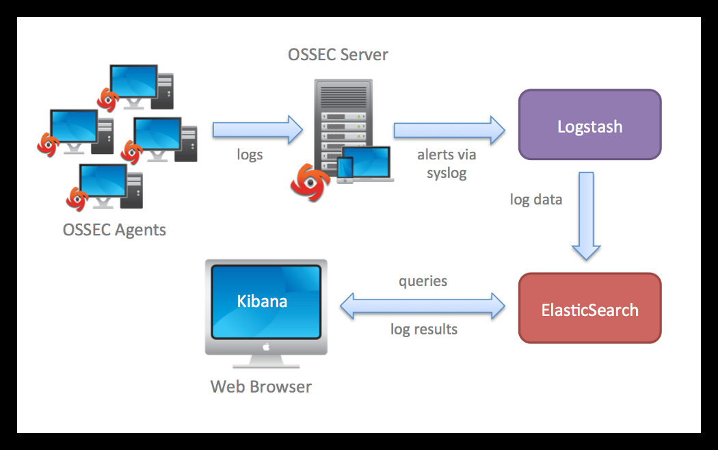
Logfiles and Event Logs
Notes:
Do you review your logs daily?
Have you configured your Event Logger to report Alerts?
Patching is so important!
Linux has Logwatch
Ossec/Logstash is a Free log correlation engine http://vichargrave.com/ossec-log-management-with-elasticsearch/. Run in a VM or you can build a server. ACT whitepaper
Note: You need to ensure the OSSEC server sits in a protected enclave: Not in DMZ or WAN

Slide 15
Anti-Virus: Know the Pedigree
The US Government Common Criteria: (https://www.commoncriteriaportal.org/products/)
Symantec (https://www.symantec.com) (HQ in Mountain View, CA)
McAfee ((http://www.mcafee.com) (HQ in Santa Clara, CA)
Trend Micro (http://www.trendmicro.com) (Office in Irving, TX. HQ in Japan)
Recommend only US based A/V solutions
Malwarebytes (https://www.malwarebytes.org/) (HQ in Santa Clara, CA)
Comodo (https://antivirus.comodo.com/) (Office in Clifton, NJ. HQ in Asia & Europe)
ESET (http://www.eset.com/us/) (Office in San Diego. HQ in Europe)
VirusTotal (https://www.virustotal.com/en/about/) (Google)
Several More – (https://en.wikipedia.org/wiki/Comparison_of_antivirus_software)
Do your homework – Know the pedigree
OpenSouce A/V – Signatures written in the Wild (What is the risk?)
ClamAV (https://www.clamav.net) (Based out of Australia)
Ransomware – Disconnect those backup drives
A/V is normally signature based. What does it do for Zero-Day and APT Malware?
Anomaly Detection
Continuous Monitoring
Notes:
Common Criteria is a tested Target of Evaluation by an approved lab
Zero-day = no signatures or ones that change to avoid detection
APT = Advance Persistent Treats, slow and low over a long period of time

Slide 16
10 things to do to deter Ransomware
1. Back up your data The single biggest thing that will defeat ransomware is having a regularly updated backup.
2. Show hidden file-extensions One way that Cryptolocker frequently arrives is in a file that is named with the extension “.PDF.EXE,” counting on Window’s default behavior of hiding known file-extensions
3. Filter EXEs in email (initial/preview read Text only – no HTML)
4. Disable files running from AppData/LocalAppData folders You can create rules within Windows or with Intrusion Prevention Software, to disallow a particular, notable behavior used by Cryptolocker, which is to run its executable from the App Data or Local App Data folders.
5. Disable RDP The Cryptolocker/Filecoder malware often accesses target machines using Remote Desktop Protocol (RDP), a Windows utility that allows others to access your desktop remotely.
6. Patch or Update your software (be current with critical & security updates)
7. Use a reputable security suite What has pedigree have to do with my A/V solution? DoD is only McAfee and Symantec. Several US vendors (e.g. Malwarebytes, Comodo…)
8. Disconnect from WiFi or unplug from the network immediately
9. Use System Restore to get back to a known-clean state Grandfather, Father, and Son
10. Set the BIOS clock back (Is your bios password protected?) Cryptolocker has a payment timer that is generally set to 72 hours, after which time the price for your decryption key goes up significantly

Slide 17
Triaging & Assessing Vendor Risk
There are a couple of key questions that should help put a given vendor’s risk profile in context:
If our organization shares sensitive or regulated information (PII, ePHI, or cardholder data) with the vendor and there’s a breach, what are the consequences?
If our organization’s operations rely on the availability of the vendor’s services and there is a service interruption, what are the consequences?
If our vendor goes out of business, what are the consequences?
Have we created a data-flow diagram to show how sensitive data moves into and out of the organization?
Not all vendors are created equal. Good vendor-management practices recognize that not every vendor requires the same level of scrutiny and diligence. Vendors and prospective vendors should be assessed based on their inherent risk profile:
Reputational Risk
Financial Risk
Operational Risk
Regulatory Risk
Privacy Risk
Environmental Risk
Legal Risk
Other

Slide 18
US-CERT Alerts
Notes:
Anyone can sign up for these email alerts – Excellent source of timely information
Also CSSP has ICS Alert Portal

Slide 19
San Diego InfraGard
Notes:
Meets Quarterly
Collaboration of business, professional, and public
Works with DHS Protection Agent and LECC
DHS 16 Critical Sectors

Slide 20
InfraGard Collaboration
Notes:
Trusted Mail distro
DHS has HSIN website

Slide 21
How to report Fraud and Exploits
Notes:
Monetary Loss and harassment

Slide 22
How to report Intellectual Property Loss
Notes:
How much are your ideas and projects worth?

Slide 23
San Diego LECC Anti-Terrorism
Notes:
FREE ILO and TLO training
FREE Anti-Terrorism training
If you see something – say something Report

Slide 24
SANS at Risk
Notes:
Daily and Weekly Digest
Do you read Darkreading, Hackernews… ?

Slide 25
SANS OUCH Report

Slide 26
San Diego Securing Our eCity

Slide 27
Summary
The threat is real and constant at all levels
The most expensive boundary & perimeter defenses can be breached by phishing and social engineering
There is a challenge to share the knowledge and awareness with family and friends. Share that knowledge!
There are several professional organizations here in San Diego if you want to get more involved: ISACA, ISSA, ISC2, HTCIA, and more.
Common Information give-away, Facebook, LinkedIn, Manta…
There is so much more to cover (e.g. RBAC, Authentication and Authorization, Secure connections, VPN, and SSH, Detailed Log Management, Backing up the Data… to name a few).
Notes:
Comerobmenow, pleaserobme
Can we say anything more about keeping you patches current?
A&A and RBAC Least Privilege. Does everyone need to be an Amin?

Slide 28
Backup

Slide 29
John Feist BIO
John Feist - Principal Cyber Security Architect and Engineer
CISSP CISA CISO CRISC FITSP-D FQNV FSO CEH CPT MCIPT MCSA
Managing Member and CISO of Applied Cyber Technologies (ACT).
Mr. Feist, combines 22 years’ experience in Communications and 25 years’ experience in Cyber Security Architecture & Engineering Design, Development, Installation, Integration, Certification and Accreditation.
Mr. Feist is currently working with DoD and commercial enterprise Cyber Security efforts, transitioning from a Defense in Depth construct toward a Continuous Monitoring capability to address Advanced Persistent Threats (APT) and “Zero Day” exploits. Serving as Information Senior Systems Security Engineer (ISSE) on the new USS Zumwalt (DDG-1000) ship class for 8 years. Member of the NAVSEA Certification and Accreditation (C&A) team.
619-701-5571 (M)
John.feist@appliedcybertech.com

Slide 30
Matt Stamper BIO
Matt Stamper - Board of Advisors & CISO In Residence
MPIA, MS, CISA, ITIL, CIPP-US
As both a Certified Information Systems Auditor (CISA) and a Certified Information Privacy Professional (CIPP-US)with public and early-stage company experience, Matt Stamper brings a broad, multi-disciplinary understanding to cybersecurity best practices to his clients. His diverse domain knowledge spans IT service management (ITSM), cybersecurity, cloud services, control design and assessment (Sarbanes-Oxley, HIPAA/HITECH), privacy, governance, enterprise risk management (ERM), sales management & individual revenue contribution, new product & service development as well as international experience in both Latin America and China. Matt excels at conveying complex cybersecurity and IT concepts to boards of directors, executive management, as well as professional service providers. His executive-level experience with managed services, cybersecurity, data centers, networks services, and ITSM provides a unique perspective on the fast-changing world of enterprise IT, IoT, and cloud services.
760-809-2164 (M)
Matt.Stamper.EAG@gmail.com

